Slide 1




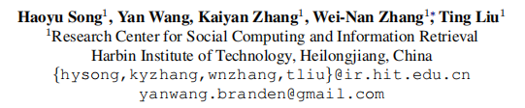





Chongqing University of Technology
ATAI
Advanced Technique of Artificial Intelligence
Chongqing University of Technology
BoB: BERT Over BERT for Training Persona-based Dialogue Models
from Limited Personalized Data
报告人：张佳棋 李戴薪

Slide 2
Title
BoB:
BERT Over BERT
for
Training Persona-based Dialogue Models
from
Limited Personalized Data

Slide 3
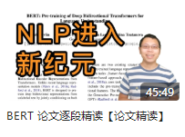
Title
BoB:
BERT Over BERT
for
Training Persona-based Dialogue Models
from
Limited Personalized Data
《BERT：Pre-training of Deep Bidirectional Transformers for Language Understanding》

Slide 4
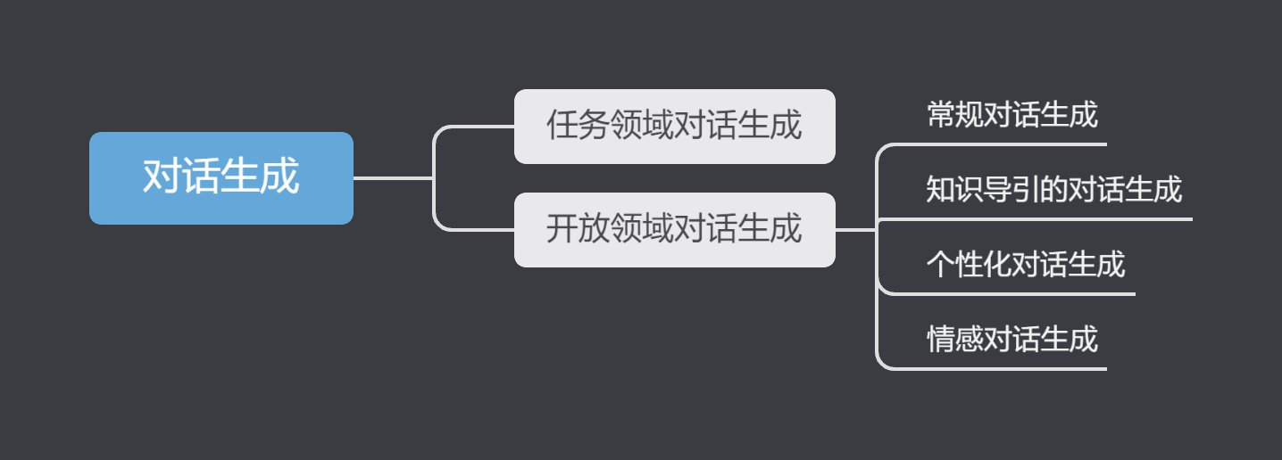
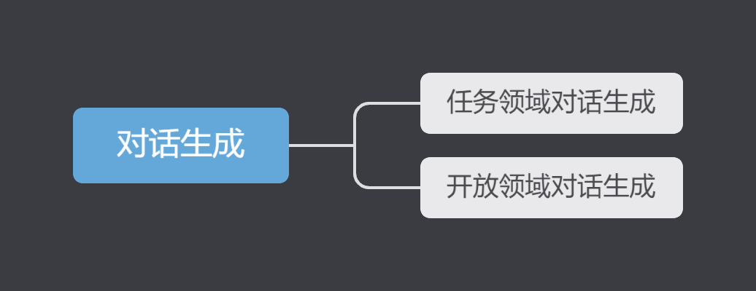
Title
BoB:
BERT Over BERT
for
Training Persona-based Dialogue Models
from
Limited Personalized Data
Notes:
常规对话生成：只接收对话历史上下文为输入，输出为符合人类对话习惯的自然语言回复。
知识导引的对话生成：除对话预料外，还提供了外部的知识信息。（结构化的知识图谱和非结构化的文本知识）。其生成的对话回复除了需要符合对话上下文信息，还可以融合外部知识信息进行更加具体、信息量更加丰富的回复生成。
个性化对话生成：除对话预料外，还引入了对话者的个性化信息（包括人物属性、对话风格等），其生成的对话回复要在符合对话上下文信息的基础上，体现对话者的个性化信息。
情感对话生成：在对话预料外还引入了情感信息，其生成的对话回复要在符合对话上下文信息的基础上，体现相应的情感特征。

Slide 5
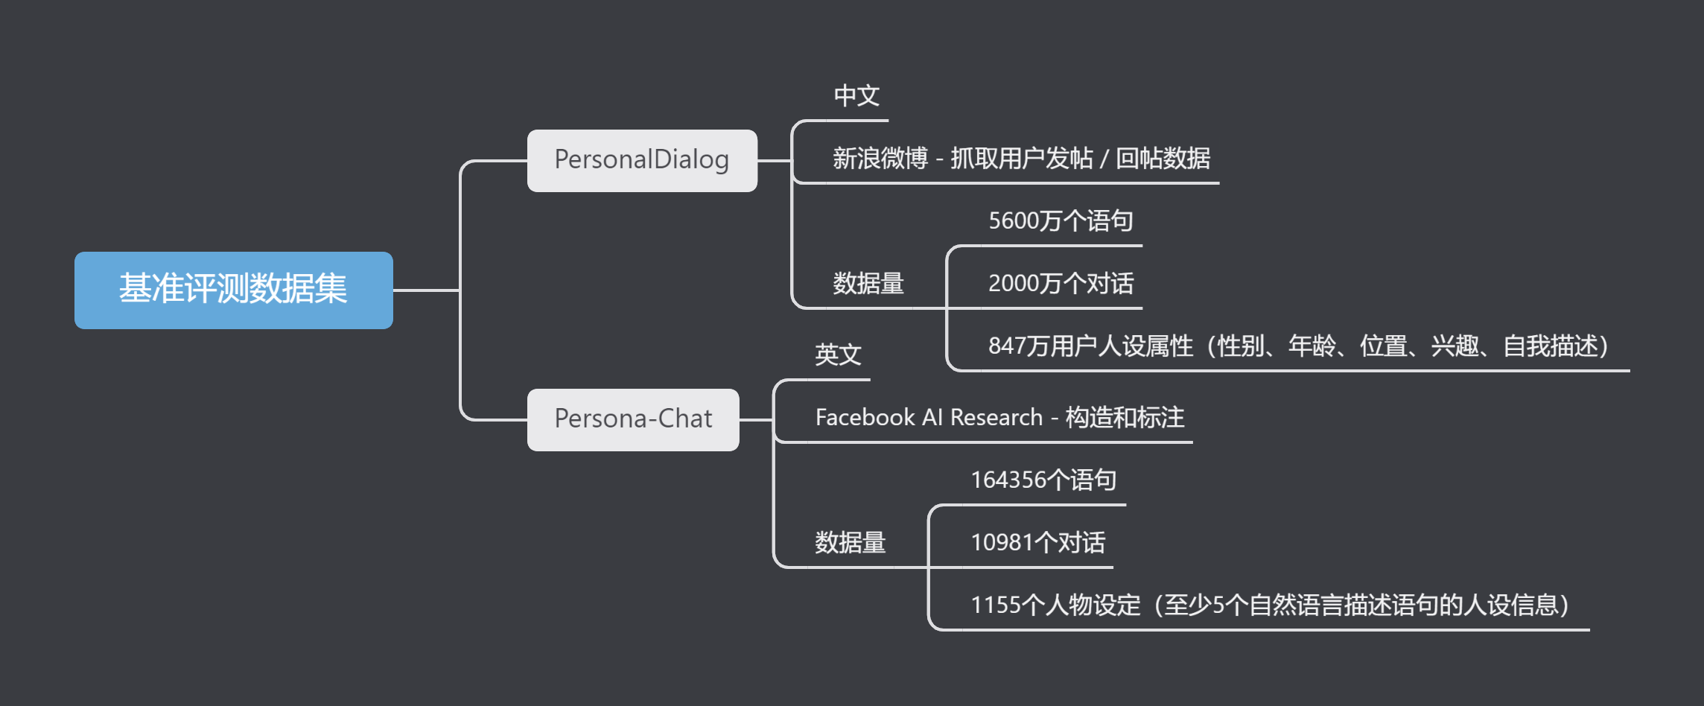
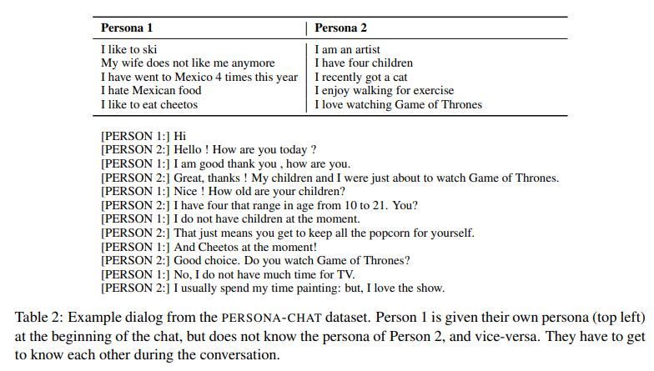
Title
Limited Personalized Data
BoB:
BERT Over BERT
for
Training Persona-based Dialogue Models
from
Limited Personalized Data
Notes:
为何说它是Limited，在这里与常规对话生成任务的数据集做一个对比：
OpenSubtitles数据集（电影字幕构成的对话语料集），包含约1亿4千万个语句、3千6百万个对话、10亿个词。

Slide 6
Title
OpenSubtitles数据集：
1亿4千万个语句
3千6百万个对话
10亿个词
Limited Personalized Data
BoB:
BERT Over BERT
for
Training Persona-based Dialogue Models
from
Limited Personalized Data
Notes:
为何说它是Limited，在这里与常规对话生成任务的数据集做一个对比：
OpenSubtitles数据集（电影字幕构成的对话语料集），包含约1亿4千万个语句、3千6百万个对话、10亿个词。

Slide 7
Author
Notes:
哈尔滨工业大学社会计算与信息检索研究中心

Slide 8
Abstract
Three Important Things:
Maintaining consistent personas is essential for dialogue agents. But the limited-scale of annotated persona-dense data are still barriers.
In this work, we show how the challenges can be addressed by disentangling persona-based dialogue generation into two sub-tasks with a novel BERT-over-BERT model.
Under different limited data settings, both automatic and human evaluations demonstrate that the proposed model outperforms strong baselines in response quality and persona consistency.

Slide 9
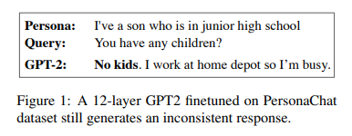
Introduction
Persona Dense
Persona-related dialogue data
Persona Sparse
Notes:
开放域对话系统旨在根据对话历史给出合适的对话回复。在现阶段下，无论是开放域对话生成模型还是开放域对话系统，面临的最大挑战之一就是对话回复的前后不一致。
相比于其他类型的缺点，比如缺乏常识、不具备感情等，用户对不一致现象的容忍度往往更低：说话过程中极少量的前后不一致就很容易导致用户脱离当前的对话语境，失去进一步对话的兴趣。
已有的研究工作表明，仅靠大规模的对话数据很难根除这类不一致的现象。
正因如此，后来的研究工作才会提出在对话中明确地引入角色信息。
Persona dense: 角色信息稠密。通过人工标注的方式，来获取基于预设角色信息的对话数据。
Persona sparse：角色信息稀疏。从社交媒体上收集用户的帖子和评论，并将公开的用户信息作为相应的角色信息。

Slide 10
Introduction
BERT-over-BERT Model
Response Generation
Persona-based dialogue system
Consistency Understanding
Encoder E
Decoder D1
Decoder D2
Notes:
为了缓解上述提到的问题，作者设计了一个新的基于BERT的模型，将理解能力和生成能力的获取分离开来。
一旦将两者拆分开来，无论是对话生成，还是一致性的理解，都能找到充足的数据资源来进行训练。
- 对话生成：对话数据集
- 对一致性理解：非对话的推理数据集，比如MNLI和SNLI

Slide 11
Main Contributions
We disentangled the task of persona-based dialogue generation into two sub-tasks: consistency understanding and dialogue generation.
A BERT-based generative framework, BoB, was proposed for training persona-based dialogue models from limited data.
An unlikelihood training method with non-dialogue inference data was introduced to enhance persona consistency understanding.

Slide 12
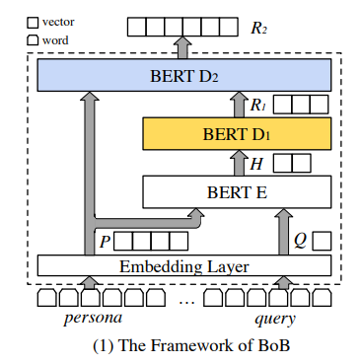

Model
Overview
the Dialogue Query
the Target Response
the Personas
the Non-dialogue Inference Data
Sentences
Vector Representations

Slide 13

Model
Disentangling

Slide 14


Model
BERT-over-BERT
Encoder

Slide 15

Model
BERT-over-BERT
Response Generation Decoder

Slide 16
Model
BERT-over-BERT
Consistency Understanding Decoder

Slide 17
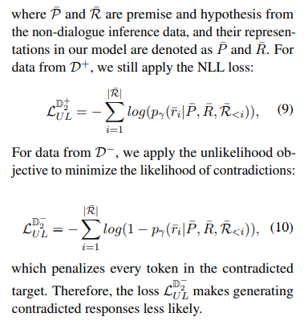
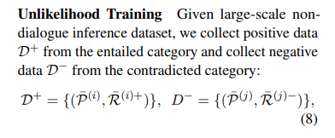
Model
Training Objectives
Unlikelihood Loss
Non-dialogue inference dataset
Premise
Hypothesis
Entailment
Contradiction
Neutral

Slide 18

Evaluation Metrics
Automatic Metrics
Human Evaluations
We recruit two teams (one for English and another for Chinese), each consists of five professional annotators.
We sample 100 {persona, query, response} tuples for each model’s evaluation under every setting.

Slide 19
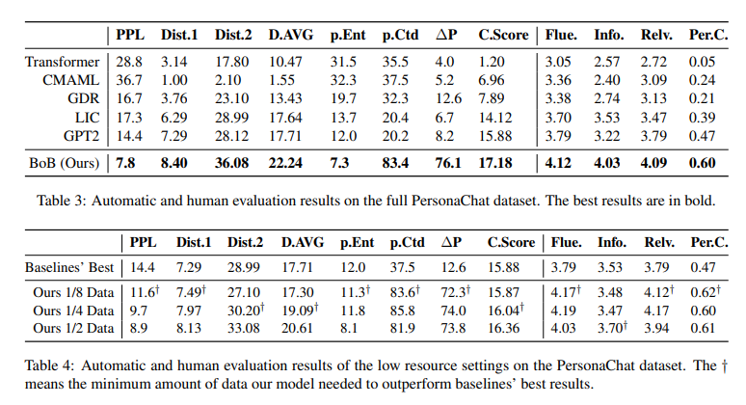
Experiments

Slide 20
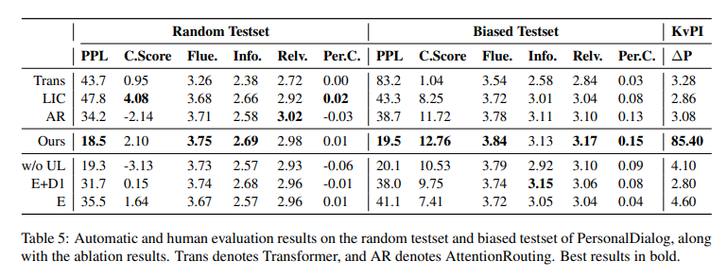
Experiments

Slide 21
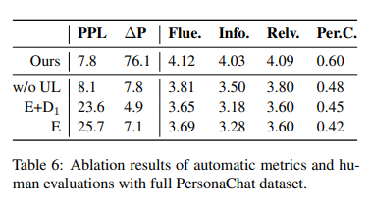
Ablation Studies

Slide 22
Conclusion
In this work, we propose a novel BERT-based dialogue model to learn from limited personalized data by disentangling response generation and consistency understanding.
Experiments on two publicly available datasets demonstrate that our model can be trained with limited personalized dialogue data while still obtain significant improvements over strong methods.

Slide 23
Chongqing University of Technology
ATAI
Advanced Technique of Artificial Intelligence
Chongqing University of Technology
Thanks
报告人：张佳棋 李戴薪

